Slide 1


City madness
Toby Flenderson

Slide 2
INTRODUCTION
Inspiration:
City exploration
Path finder
Artistic vision:
Different user experience
Multimodal feedback

Slide 3
HACKATON PROTOTYPE
Graphic interface
User interaction
Audio feedback

Slide 4
ARTISTIC INSTALLATION OVERVIEW
HUMAN-COMPUTER INTERACTION
GRAPHIC INTERFACE
Processing
AUDIO FEEDBACK
Pure Data

Slide 5
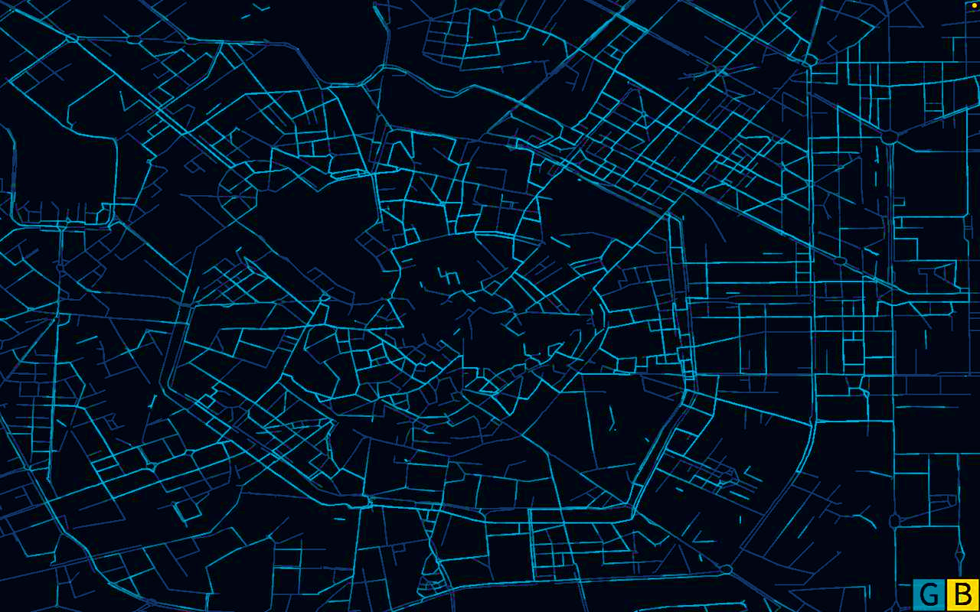
Particles system
City composition fetch from geographical data.
3 types of particles.
- City streets
- User path
- User motion

Slide 6
User interaction
Click anywhere in the window to set the starting and final point of the journey.
Select between two path generation modes

Slide 7
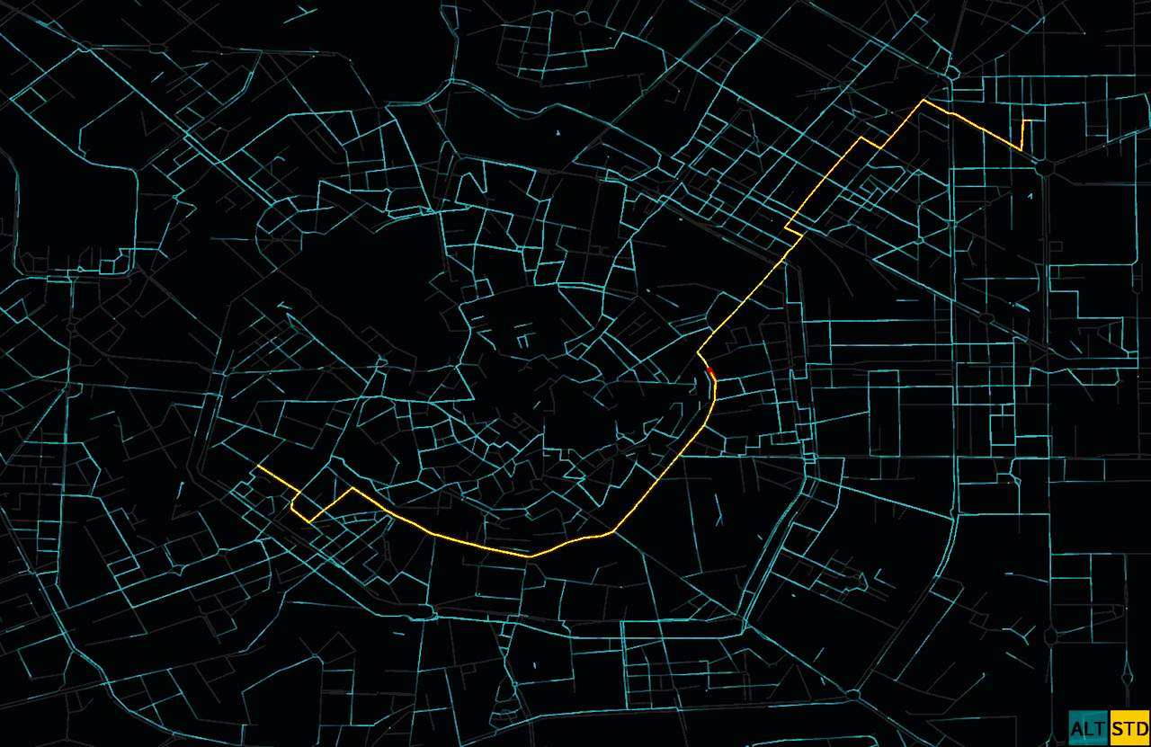
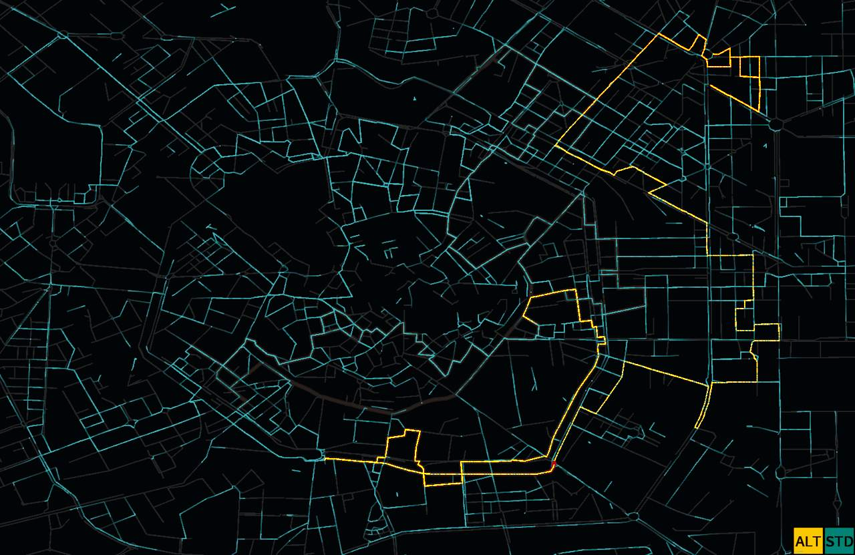
PATH GENERATION
Standard path:
Each node present in the path, triggers a note
“Std mode” does not consider dissonances between consecutives notes.
It is the shortest way between the beginning and the final of the journey.
Alternative path:
“Alt mode” considers a note pool in which the notes have a higher degree of consonance.
It could not be the shortest way between the points, but the less dissonant.

Slide 8
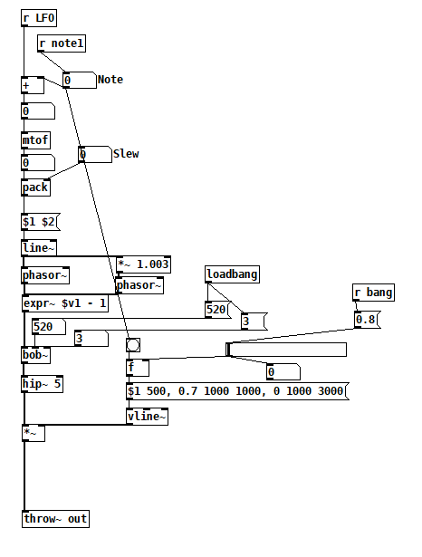
AUDIO FEEDBACK
OSC messages from processing.
Decodes MIDI note number to frequency.
Sawtooth oscillator + filtering + delay + reverb.
Vibrato’s depth depends on the mode

Slide 9
FURTHER DEVELOPMENTS
Pathfinder algorithm in which we are able to embed the quality of the streets.
Add music grammar rules in such a way that more complex sequences (paths) will be generated
Better representation of the map
Better ways of user-application interaction
More layers in the sound design.

Slide 10
demo

